Slide 1
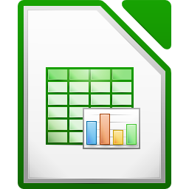


Spreadsheet
Class VI
lab 21

Slide 2
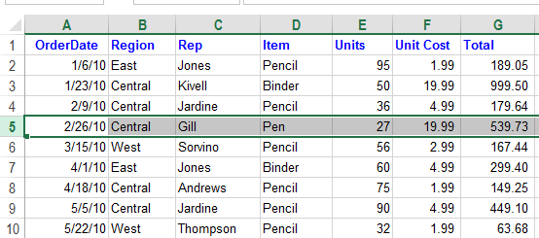
What is Spreadsheet
An electronic document in which data is arranged in the rows and columns of a grid

Slide 3
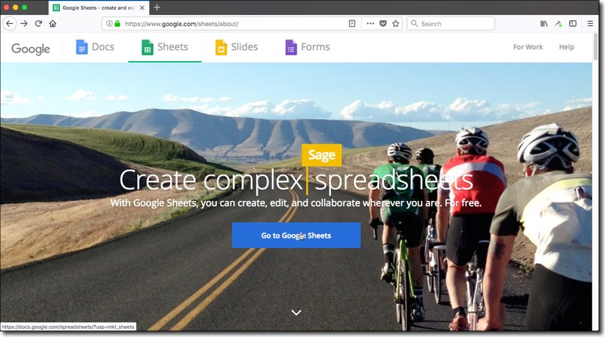
Spreadsheet Software
Microsoft Excel
Google Sheets
WPS Spreadsheets
Libre Office Calc
EtherCalc

Slide 4
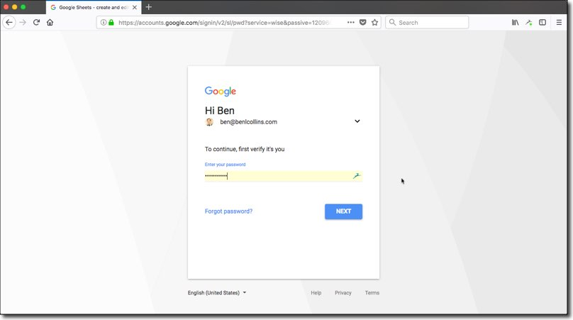
Google Sheets
Go to
https://www.google.com/sheets/about/
and sign up with your email and password

Slide 5
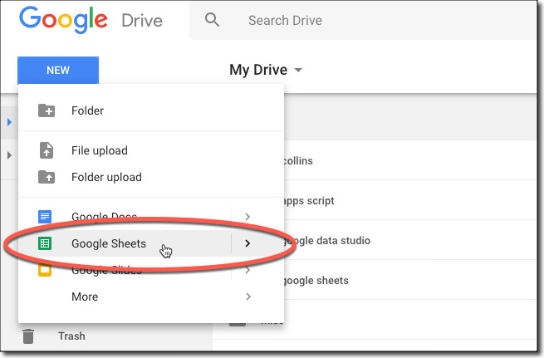
Google Sheets
Go to Drive and click on
Google Sheets

Slide 6
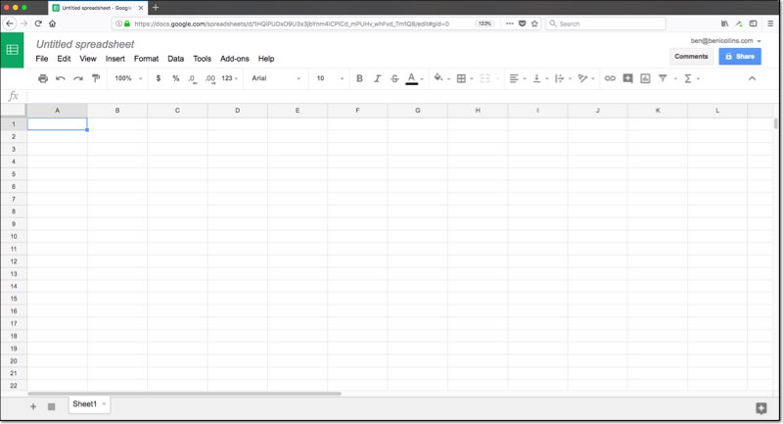
Google Sheets
Editing window
will appear

Slide 7



